Slide 1


Lottery Class of 2030

Slide 2
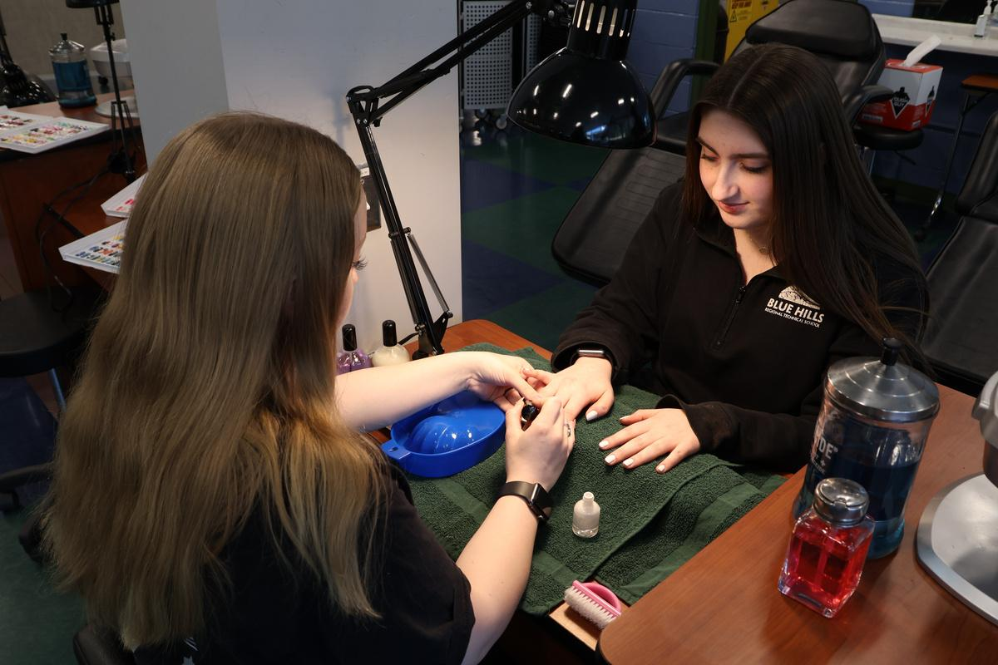
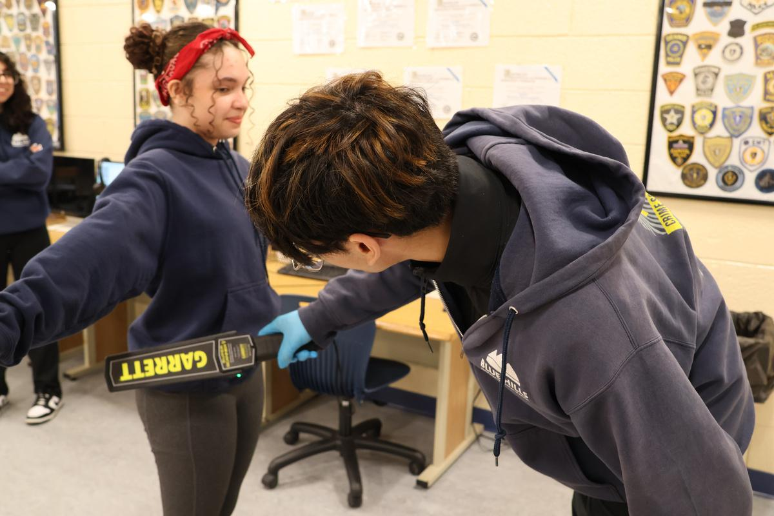
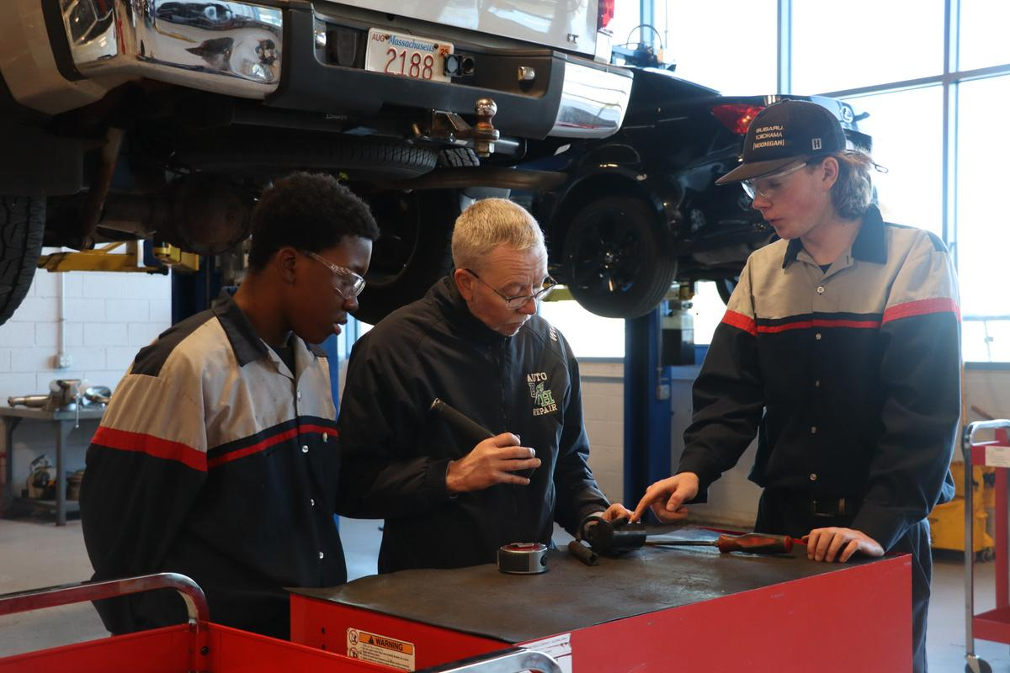
Blue Hills Regional Technical School
February 25, 2026
WHO IS INCLUDED IN THIS LOTTERY?
Today’s lottery includes eligible students who submitted complete applications by the January 1, 2026, priority deadline for the Class of 2030
Eligible students who submitted complete applications after the January 1, 2026, priority deadline will be included in a subsequent lottery, should one be necessary
APPLICANT NUMBER AND WEIGHTS
Each application has been assigned a unique number. Students and families can log into their application through the Blue Hills website (using the same process as when they applied) to view their applicant number, check the number of weights assigned to their application, and review their application status
WEIGHT ASSIGNMENT
Every complete application receives one lottery weight. Additional lottery weights are assigned in accordance with our admissions policy based on attendance and behavior criteria, for a maximum of three weights total

Slide 3

Blue Hills Regional Technical School
February 25, 2026
HOW DOES THE LOTTERY WORK?
The lottery is conducted randomly by computer
Each applicant number will be assigned a rank based on the lottery results
Applications with more weights have proportionally greater chances of being selected earlier in the lottery
Students receiving ranks 1-250 are offered admission
The remaining applicants will be waitlisted according to their rank

Slide 4




Blue Hills Regional Technical School
February 25, 2026
WHAT HAPPENS AFTER THE LOTTERY
VIDEO POSTED
RESULTS POSTED
FAMILIES RESPOND
The recording of this livestream will be posted on the Blue Hills website
A copy of the lottery results will be posted on the Blue Hills website
Accepted students must accept or decline their offer within seven business days

Slide 5
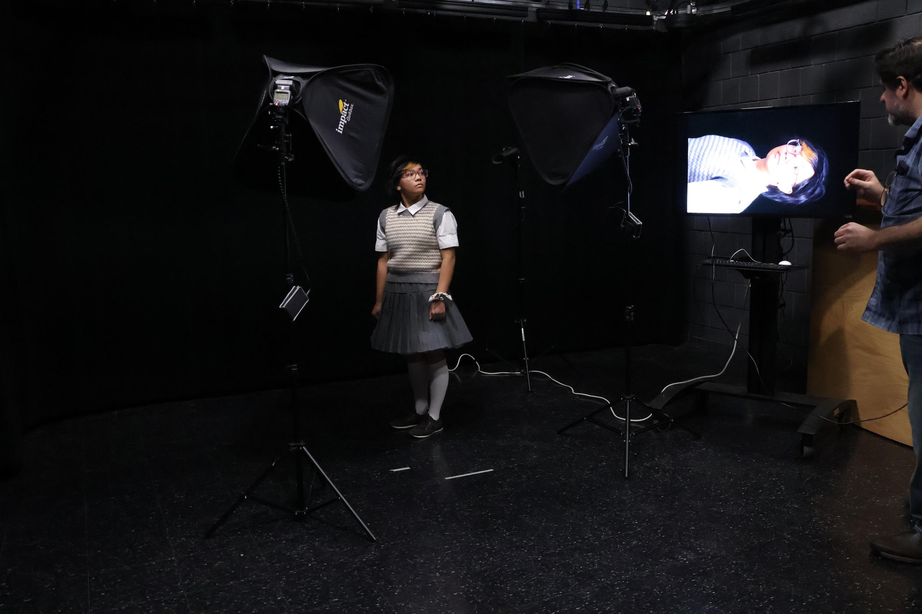
Blue Hills Regional Technical School
February 25, 2026
ACCEPTING OFFER OF ADMISSION
Within 24 hours of this livestream lottery, an email will be sent to families with instructions to accept or decline the offer of admission
Families have until Friday, March 6, 2026, at 8:00 PM to accept their offer (7 business days)
Families who do not respond by the deadline listed above will forfeit their seat
Waitlisted students will be offered admission as seats become available, in waitlist rank order, in accordance with our admissions policy
Each family is given up to 7 business days to accept their offer

Slide 6

Blue Hills Regional Technical School
February 25, 2026
HOW THE WAITLIST WORKS
WAITLIST PROCESS
Students ranked 251 and higher in the lottery are placed on a waitlist in numbered order
The Admissions Office contacts students from the waitlist in numerical order as seats become available
Parents/guardians must accept or decline offers within 7 business days of receipt
Failure to respond within 7 days results in forfeiture of the seat
Waitlists expire on October 1 of the same calendar year

Slide 7
Blue Hills Regional Technical School
February 25, 2026
IF ACCEPTED, NEXT STEPS
RECORDS
PLACEMENT
1
Blue Hills will contact sending districts to request and gather official student records for all accepted students
3
All accepted students will be required to complete placement exams; more information will be provided
ACCEPTANCE RECEPTION
TRANSITION MEETING
2
Join us on Thursday, March 26, 2026, at 6:00 PM to celebrate your admission, meet staff and faculty, and learn more about the Blue Hills community
4
Families of students with IEPs or 504 plans will be contacted to schedule individual transition meetings to ensure appropriate supports are in place

Slide 8


THANK YOU
www.bluehills.org/admissions
admissions@bluehills.org

